Slide 1
Data Types and Arithmetic Operators
Michael Rutalo

Slide 2
Variables
Are used to store data on which manipulations are to be made
Variable names correspond to locations in the computer's memory
Every variable has a name, a type, a size and a value
Whenever a new value is placed into a variable (through scanf, for example), it replaces (and destroys) the previous value
Reading variables from memory does not change them

Slide 3
C Data Types
A Data type defines what values can be stored in a named variable.
C has a small family of datatypes.
Numeric (int, float, double)
Character (char)
User defined (struct, union, enum)

Slide 4
Data types continued
Integers;
declared using int
Used to store integer values (no decimal places)
Float;
Declared using float
Used to store floating point values (numbers with decimal places)
Character
Declared using char
Used to store characters (e.g ‘a’, ‘b’,…)

Slide 5
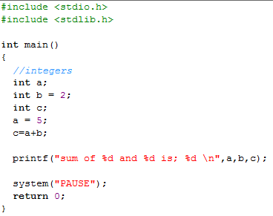
Variables simple example
Definitions of variables
Assignment and manipulation on variables
Printing Variables

Slide 6
Example continued
int a; int b = 2, int c;
Definition of variables
Variables: locations in memory where a value can be stored
int means the variables can hold integers (-1, 3, 0, 47)
Variable names (identifiers)
a,b,c
Identifiers: consist of letters, digits (cannot begin with a digit) and underscores( _ )
Case sensitive
Definitions appear before executable statements
If an executable statement references and undeclared variable it will produce a syntax (compiler) error

Slide 7
Outline
fig02_05.c
Definitions of variables
scanf obtains a value from the user and assigns it to integer1
scanf obtains a value from the user and assigns it to integer2
Assigns a value to sum

Slide 8
scanf
scanf( "%d", &integer1 );
Obtains a value from the user
scanf uses standard input (usually keyboard)
This scanf statement has two arguments
%d - indicates data should be a decimal integer
&integer1 - location in memory to store variable
& is confusing in beginning – for now, just remember to include it with the variable name in scanf statements
Other possible arguments instead of %d include; %f for floats and %c for characters
When executing the program the user responds to the scanf statement by typing in a number, then pressing the enter (return) key

Slide 9
Assignment operator and printing variables
= (assignment operator)
Assigns a value to a variable
Is a binary operator (has two operands)
sum = variable1 + variable2;
sum gets variable1 + variable2;
Variable receiving value on left
printf( "Sum is %d\n", sum );
Similar to scanf
%d means decimal integer will be printed. For float use %f.
%d will be replaced with sum which specifies what integer will be printed
Calculations can be performed inside printf statements
printf( "Sum is %d\n", integer1 + integer2 );

Slide 10
Arithmetic
Arithmetic calculations
Use * for multiplication and / for division
Integer division truncates remainder
7 / 5 evaluates to 1
To divide with the aim of answer in floats use float variable types
Modulus operator(%) returns the remainder
7 % 5 evaluates to 2
Operator precedence
Some arithmetic operators act before others (i.e., multiplication before addition)
Use parenthesis when needed
Example: Find the average of three variables a, b and c
Do not use: a + b + c / 3
Use: (a + b + c ) / 3

Slide 11
Fig. 2.9 | Arithmetic operators.

Slide 12
Fig. 2.10 | Precedence of arithmetic operators.

Slide 13
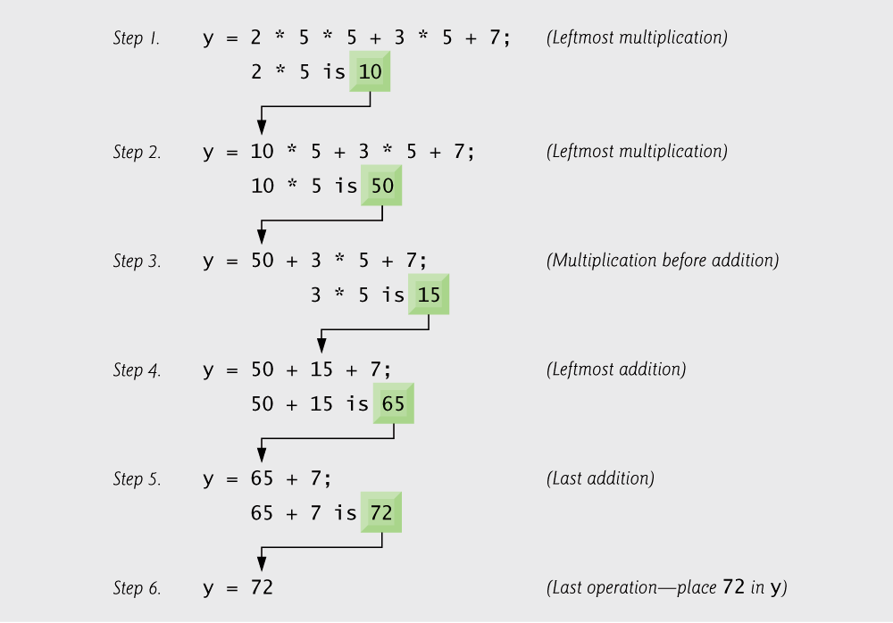
Fig. 2.11 | Order in which a second-degree polynomial is evaluated.

